Slide 1

Texas Water!
Robert E. Mace, Ph.D., P.G.
Texas Water Development Board
presented to
The LSSS, RACSS, and LRL
Professional Development Seminar
Austin, Texas; October 5, 2015

Slide 2



data
planning
financing

Slide 3
The following presentation is based upon professional research and analysis within the scope of the Texas Water Development Board’s statutory responsibilities and priorities but, unless specifically noted, does not necessarily reflect official Board positions or decisions.

Slide 4
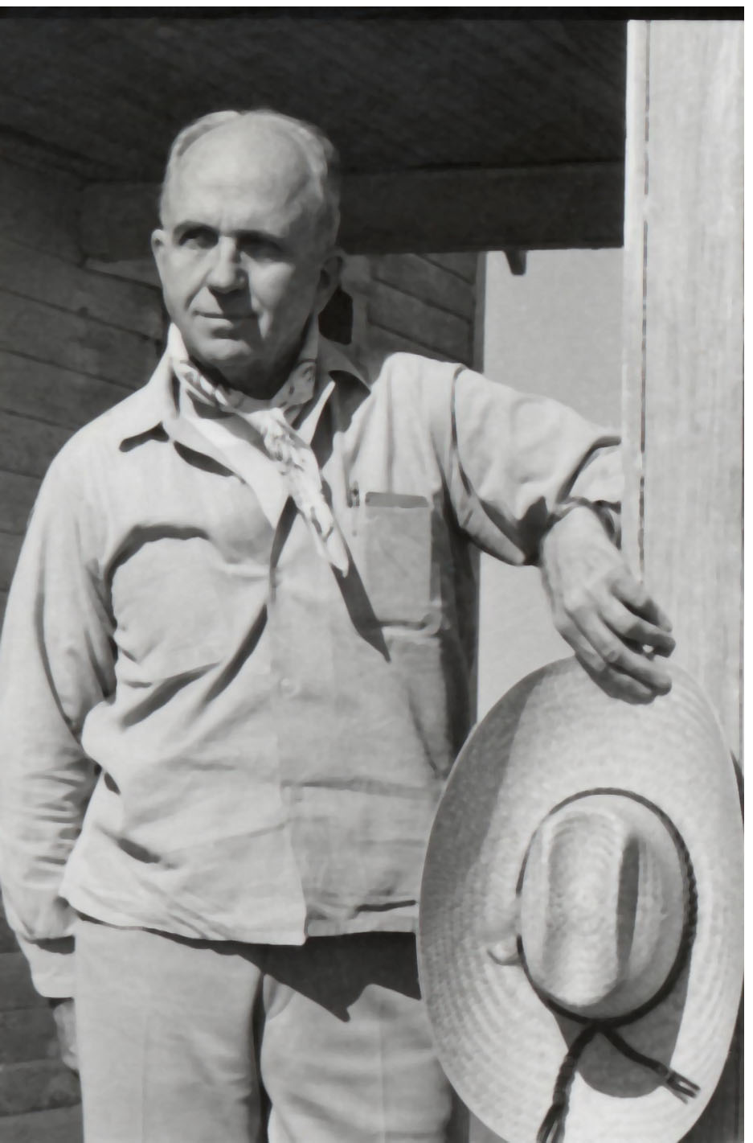
“Water, not oil, is the lifeblood of Texas.”
  James A. Michener

Slide 5
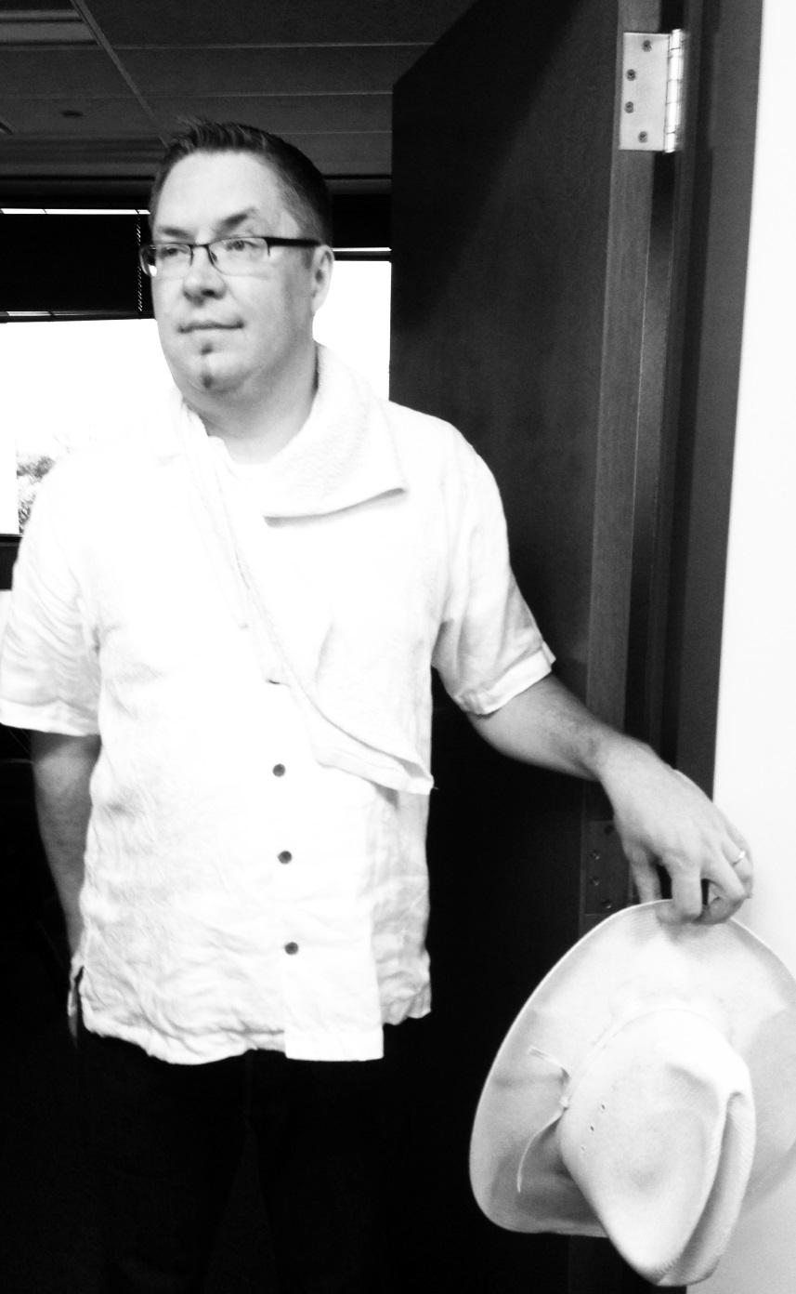
“I wish we water boys were paid like them
oil boys.”
  Robert E. Mace

Slide 6

acre-foot
= one acre with a foot of water on it
= a football field with
a foot of water on it
= about 326,000 gallons
X 326,000
= water for about 10 people for a year

Slide 7
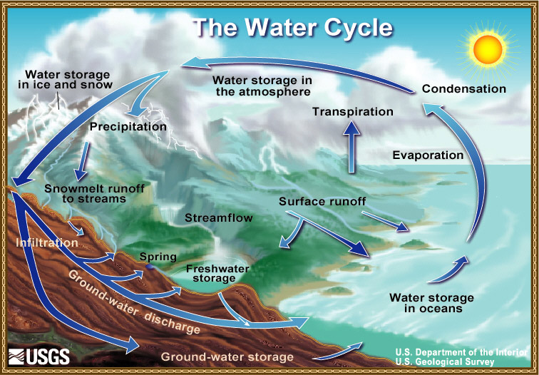

Slide 8


Slide 9
Atlantic
Multi-decadal
Oscillation
Pacific
Decadal
Oscillation

Slide 10
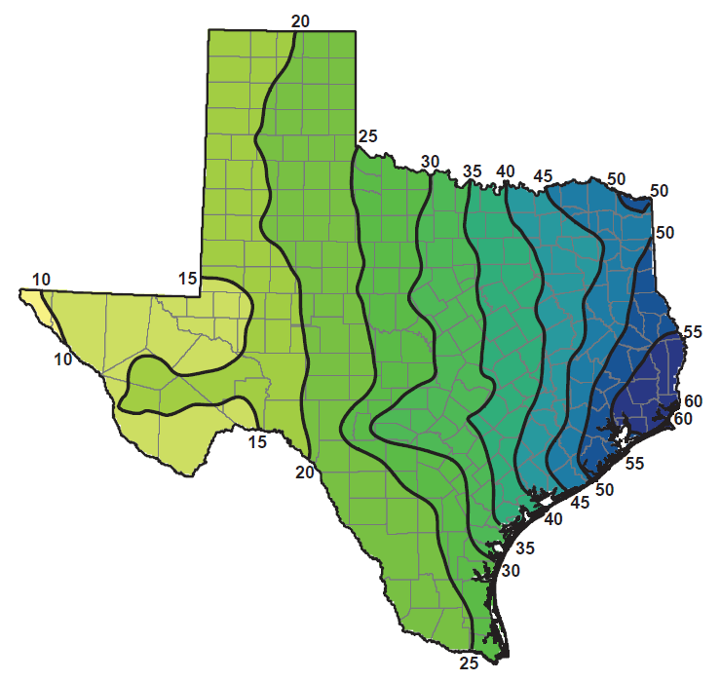
Average annual precipitation
(1981 to 2010)
from 2012 State Water Plan

Slide 11
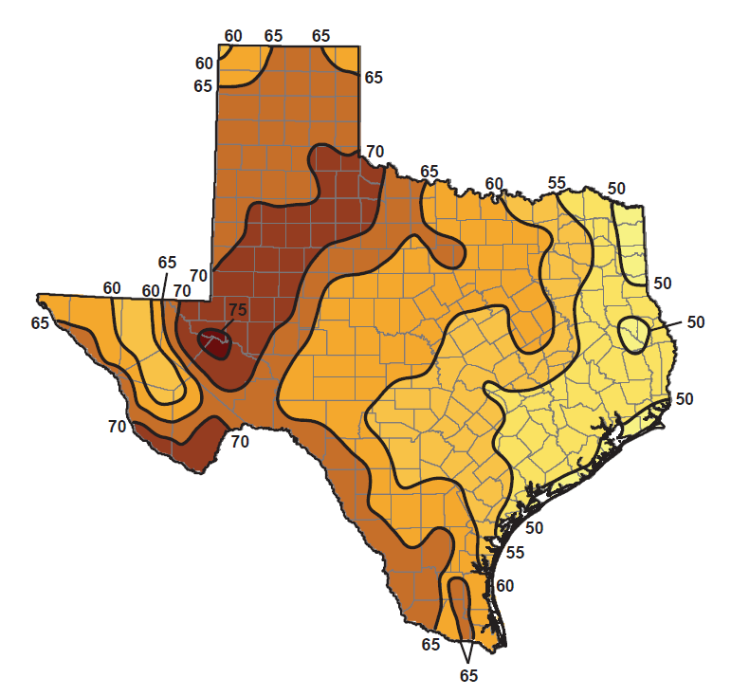
Average annual evaporation
(1981 to 2010)
from 2012 State Water Plan

Slide 12
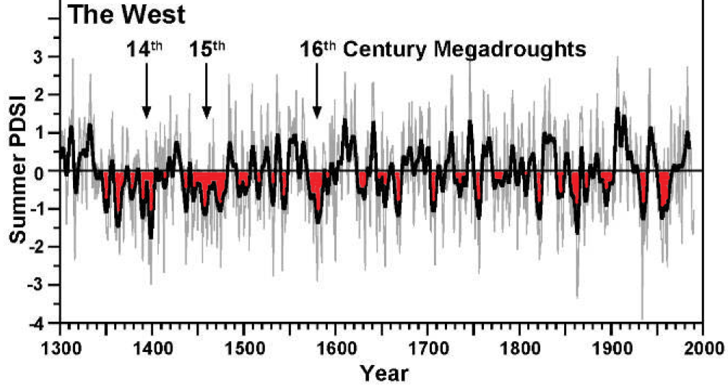
tree rings

Slide 13
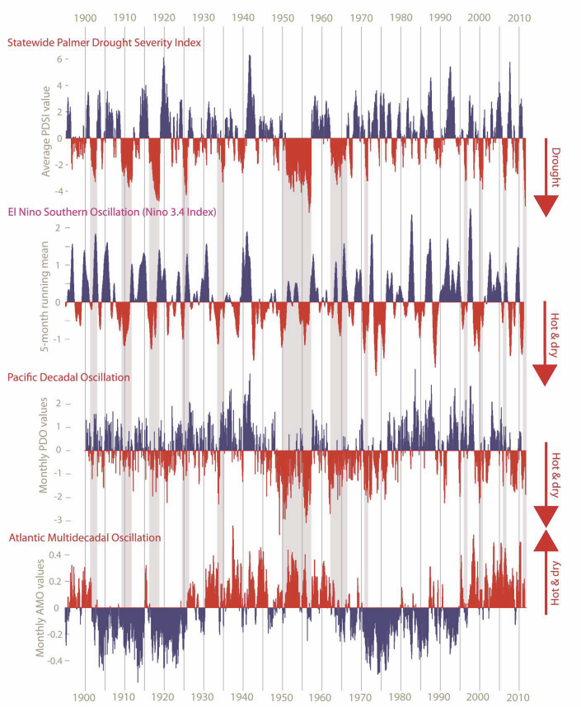
Palmer Drought
Severity Index
El Nino
Southern Oscillation
Pacific
Decadal Oscillation
Atlantic
Multidecadal Oscillation

Slide 14
All numbers in acre-feet per year
for Texas
atmosphere
86%
precip
379,000,000
ET
320,000,000
evap
7,200,000
surface water
47,200,000 into lakes and rivers from runoff
4,700,000 into lakes and rivers from rainfall
recharge
5,100,000
baseflow
1,300,000
groundwater
1.3%
Texas coast: 35,000,000
data from Ward and Valdes (1995)
Other states: 9,300,000
85%

Slide 15
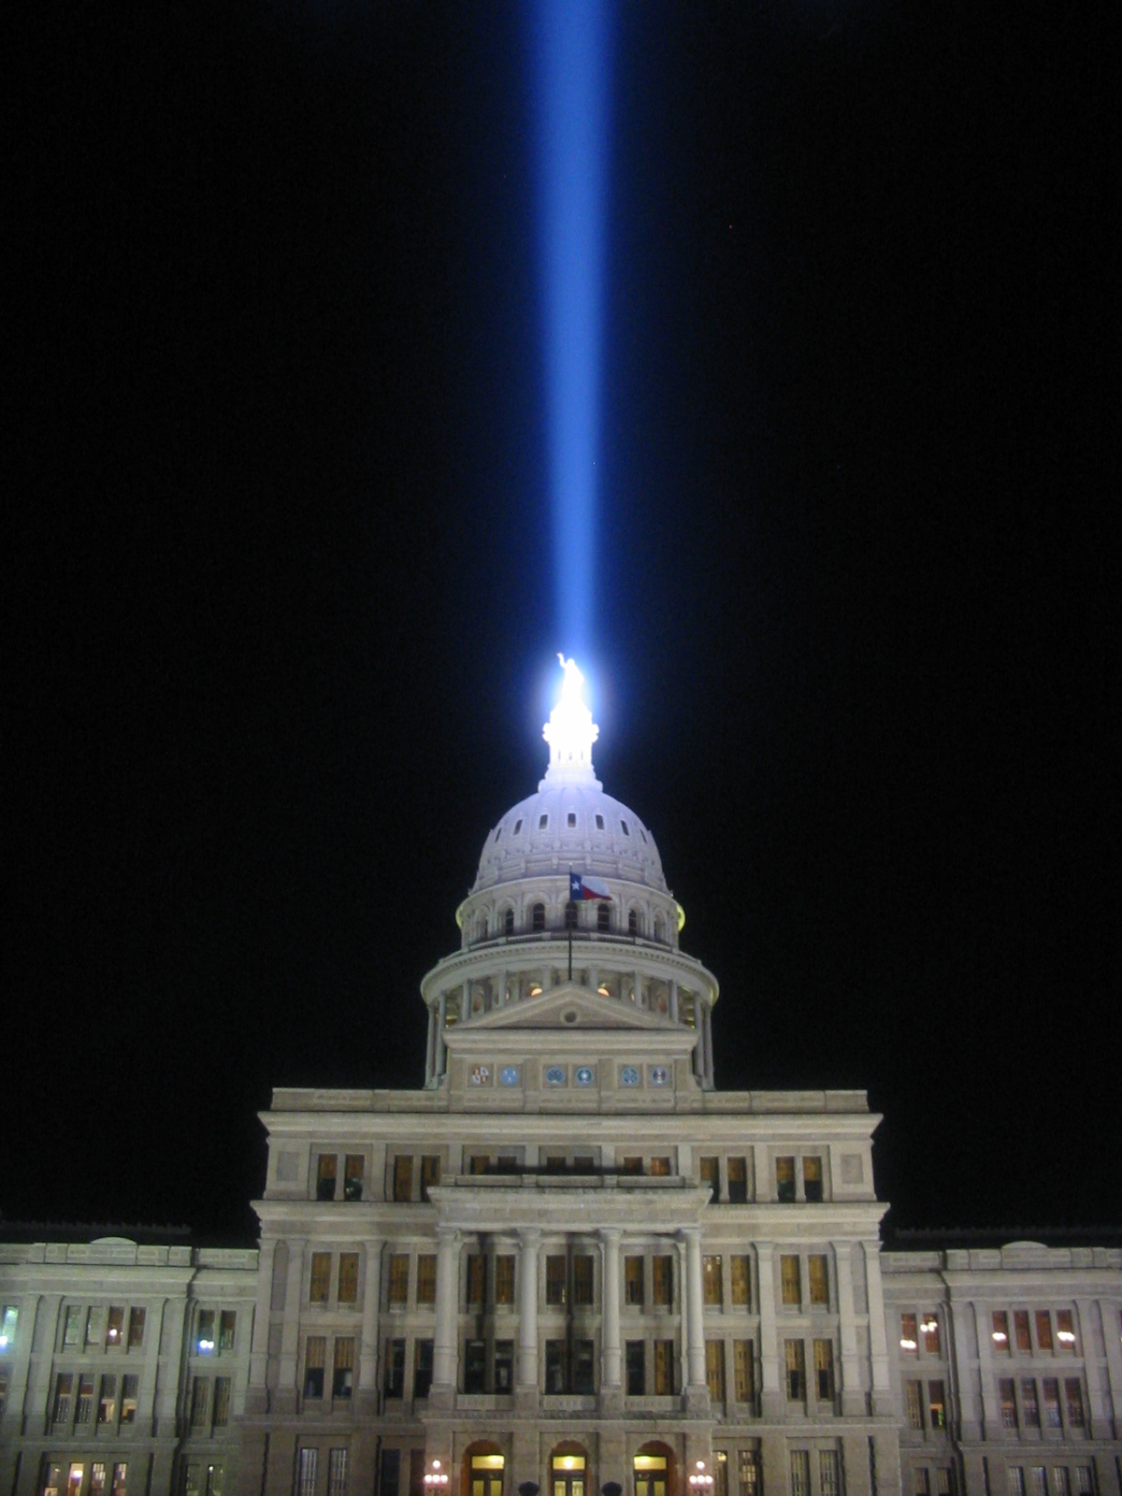
Rainwater is essentially private property in Texas
Notes:
Updates on 2005 lege session

Slide 17
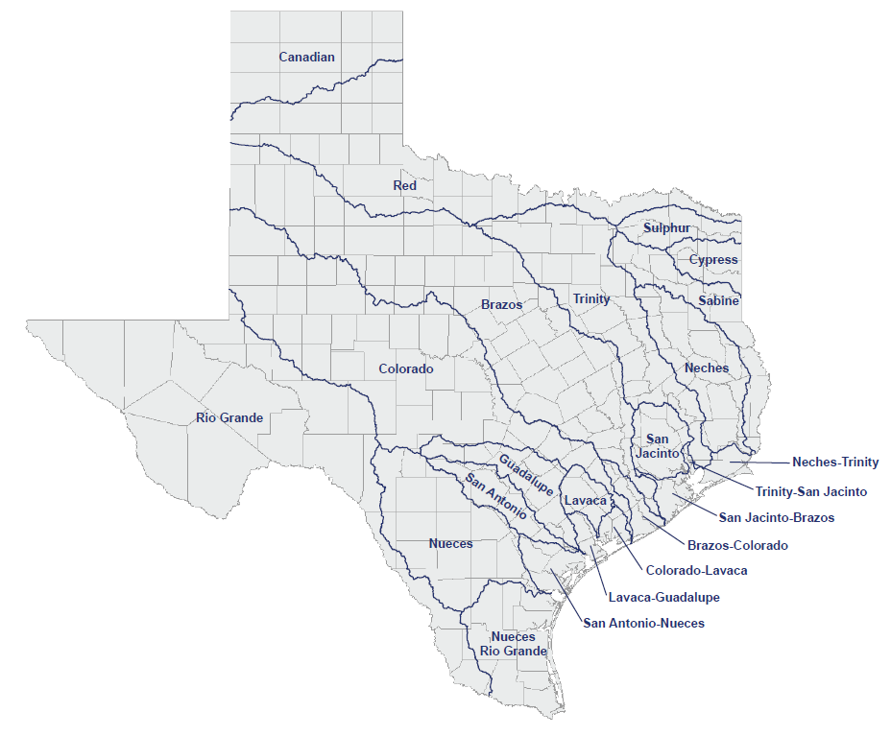
Major River Basins

Slide 18
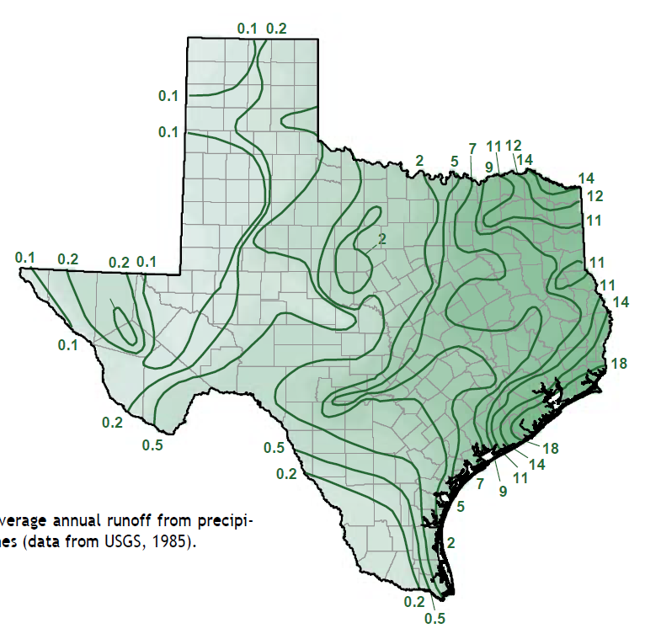
Average annual runoff
(inches)

Slide 19


Slide 20
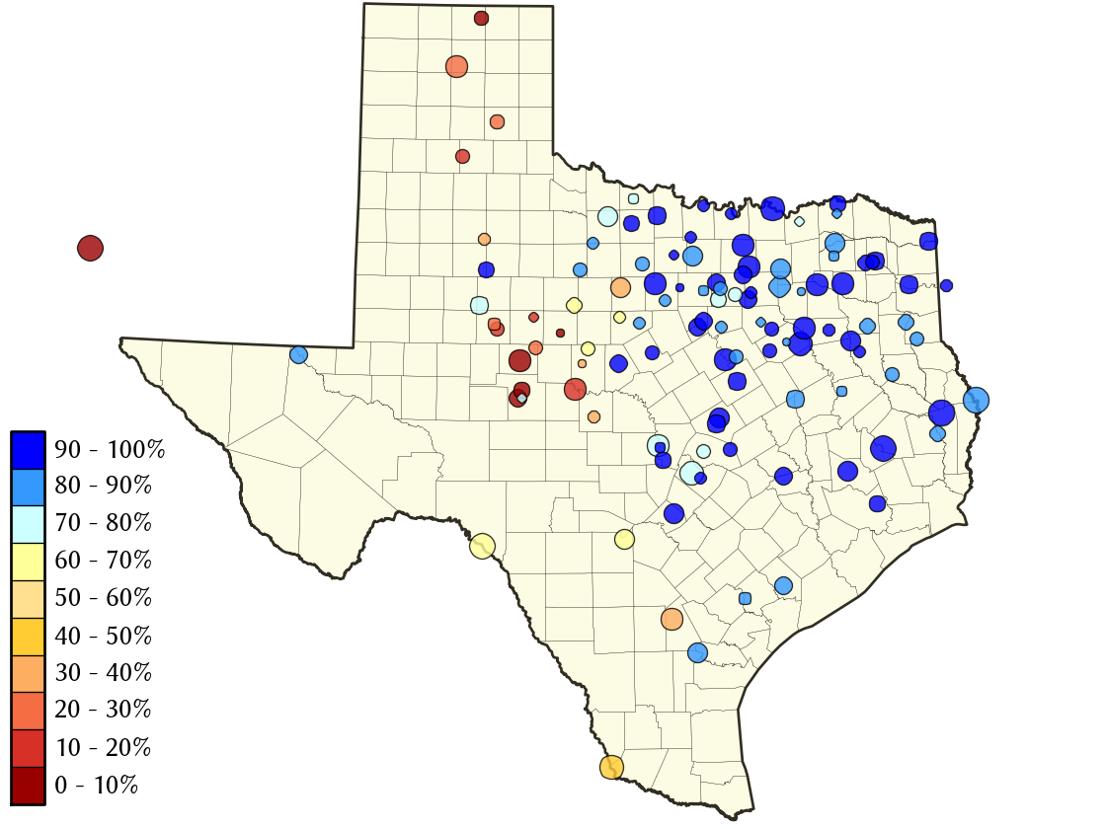
Reservoir Levels
as of September 25, 2015

Slide 21
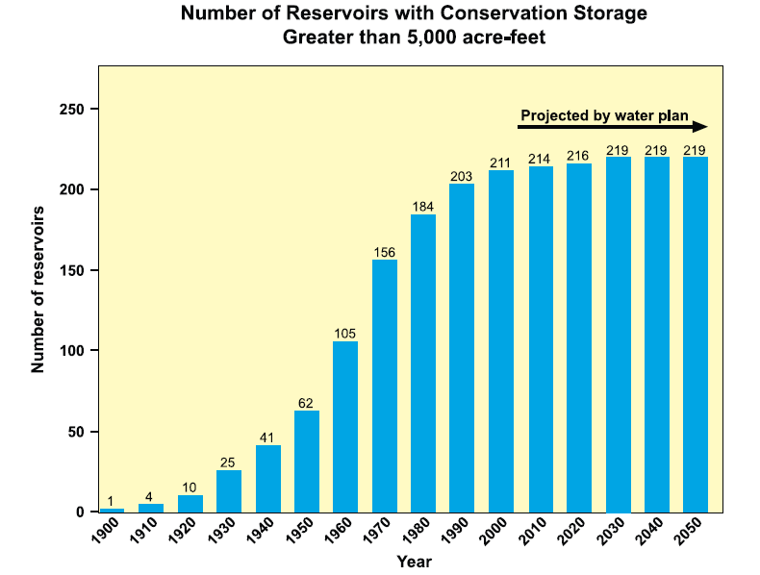
2002 State Water Plan

Slide 22
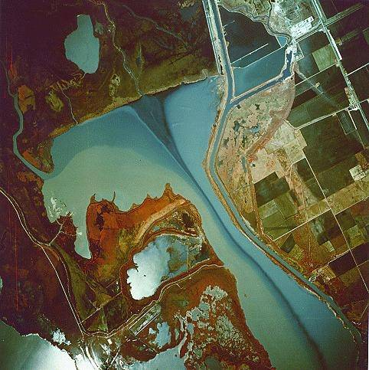
bays
and
estuaries
Guadalupe River flowing into San Antonio Bay
Notes:
Color IR Aerial Photo- Seven sources of freshwater, with their differing concentrations of sediments and nutrients, are seen flowing into San Antonio Bay and the Guadalupe Estuary, Texas (1977).

Slide 23
All numbers in acre-feet per year
for Texas
atmosphere
86%
precip
379,000,000
ET
320,000,000
evap
7,200,000
surface water
47,200,000 into lakes and rivers from runoff
4,700,000 into lakes and rivers from rainfall
recharge
5,100,000
baseflow
1,300,000
groundwater
1.3%
Texas coast: 35,000,000
data from Ward and Valdes (1995)
Other states: 9,300,000
85%

Slide 24
Amalgam of Spanish, Mexican, and Texan law
Overland flow: private property
In a stream course: state property
  Unless you have a bed and banks permit
Prior appropriation
  1st in time, 1st in right
  Usufructable
  Superior rights
Managed by Texas Commission of Environmental Quality
Notes:
Updates on 2005 lege session

Slide 26
Your aquifer
as a bathtub
Spring/
base
flow
Recharge
Aquifer
Pumping
Notes:
Mention availability: recharge and storage in the tub
Paradox of availability

Slide 27
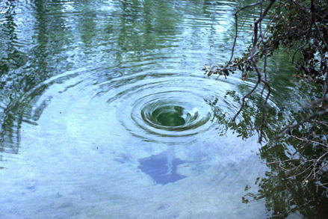
recharge

Slide 28
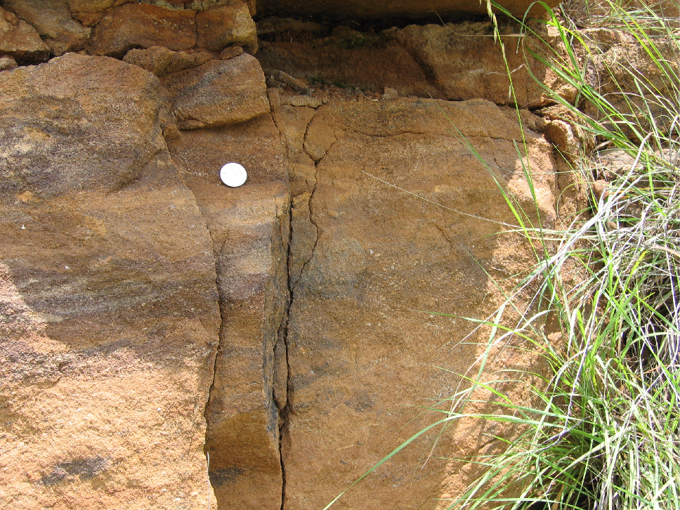
Hickory Aquifer, sandstone
Notes:
Hickory Aquifer, Llano uplift area, near Honey Creek (HW 71)

Slide 29
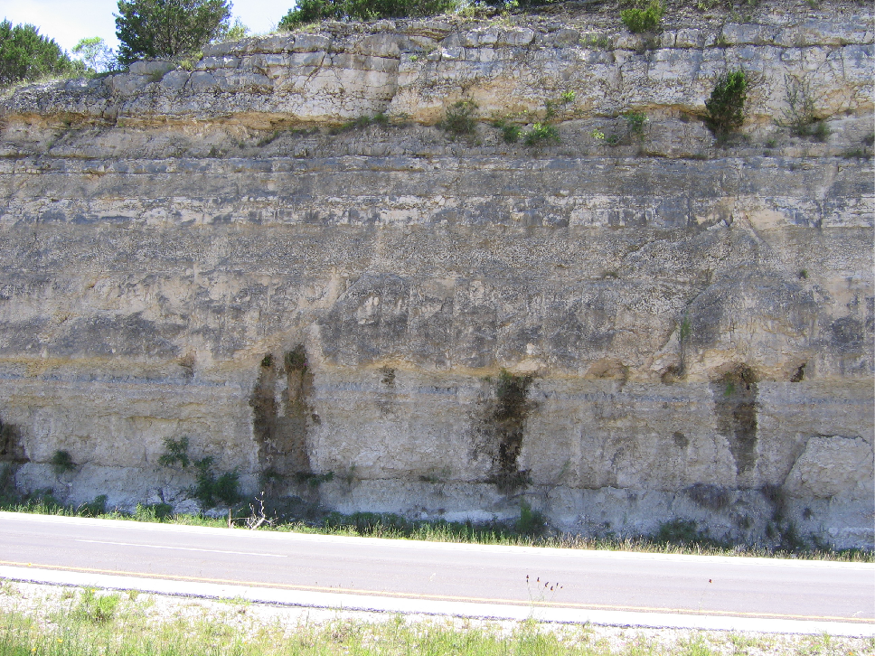
Edwards-Trinity (Plateau) Aquifer, limestone
Notes:
Edwards-Trinity Plateau Aquifer (Fort Terrett Mbr), Interstate 10 near Kerrville

Slide 30
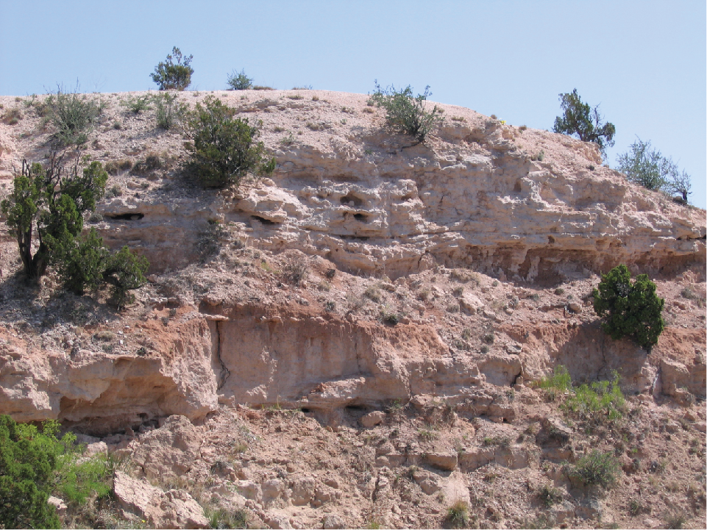
Ogallala Aquifer, sand and gravel
Notes:
Ogallala Aquifer near the entrance to Palo Duro Canyon State Park

Slide 31
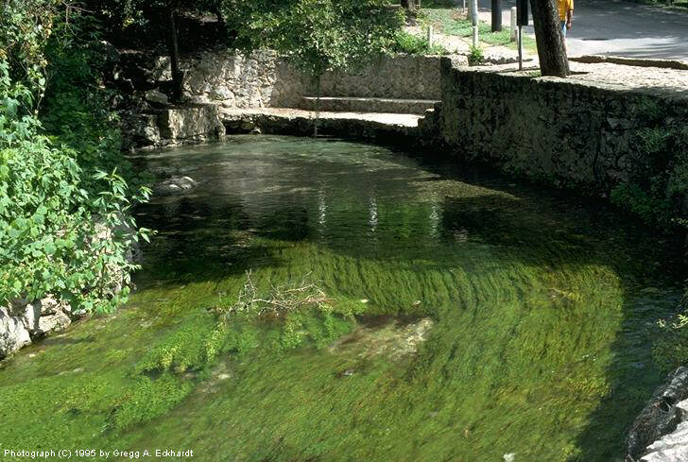
Comal Springs

Slide 32
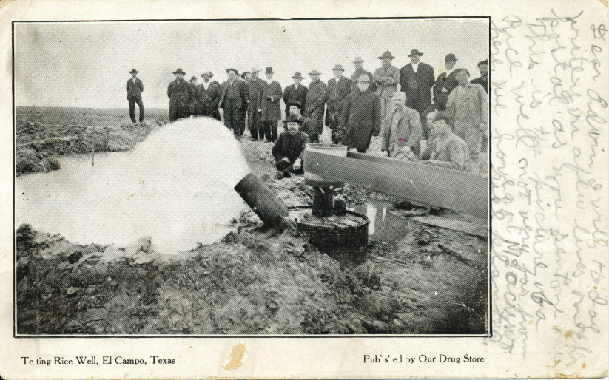

Slide 33
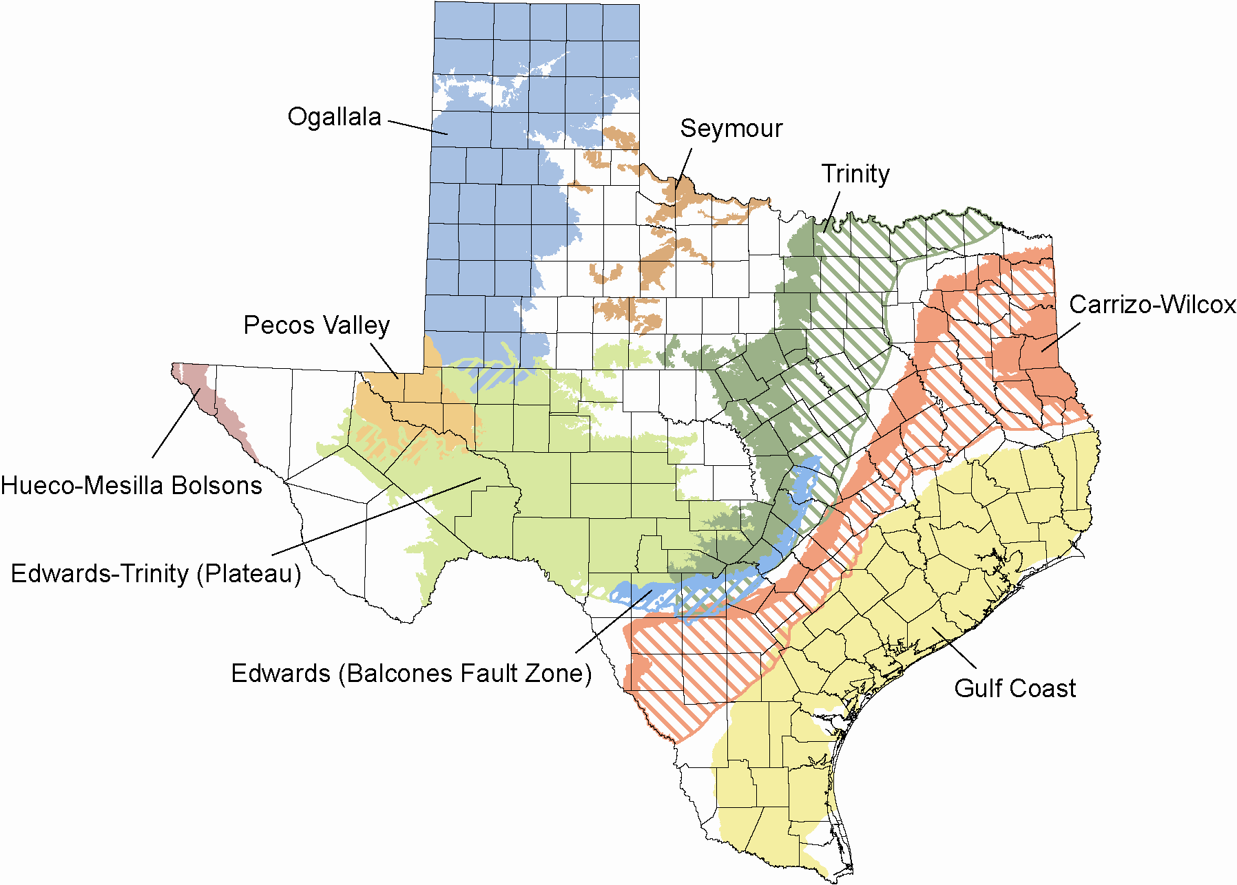
Major aquifers

Slide 34
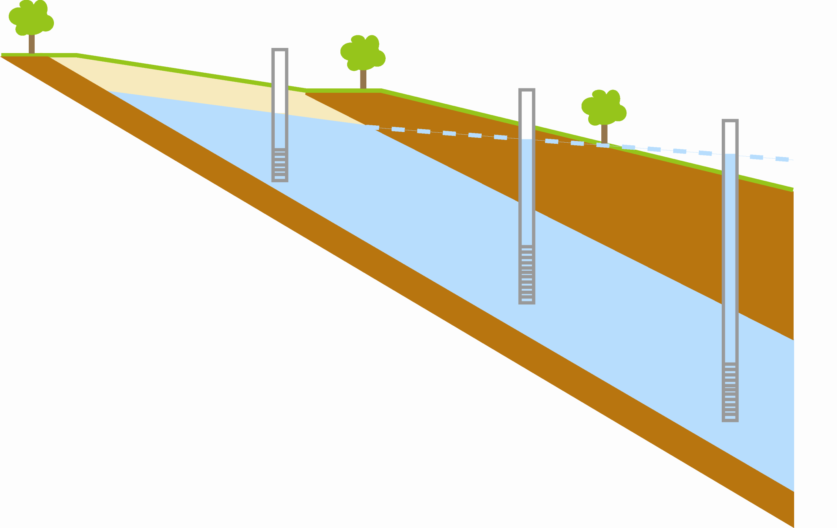
same aquifer: unconfined and confined
Notes:
Which way is the water flowing?

Slide 35
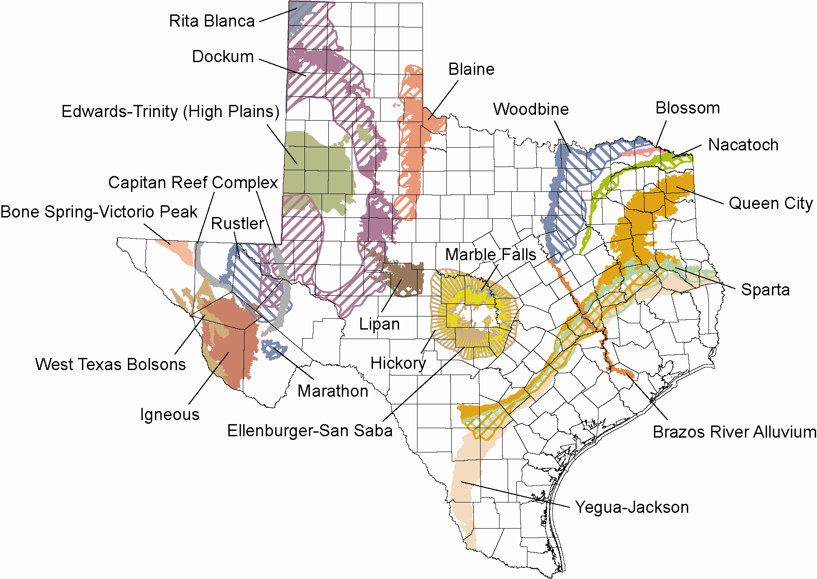
Minor aquifers

Slide 36
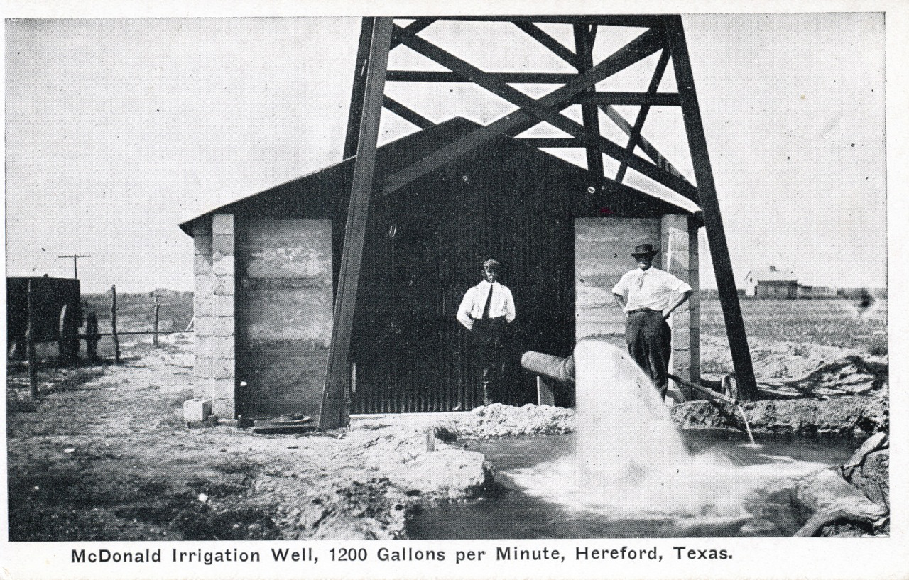
Notes:
McDonald is credited with bringing high volume irrigation to the High Plains of Texas back in 1910.

Slide 37
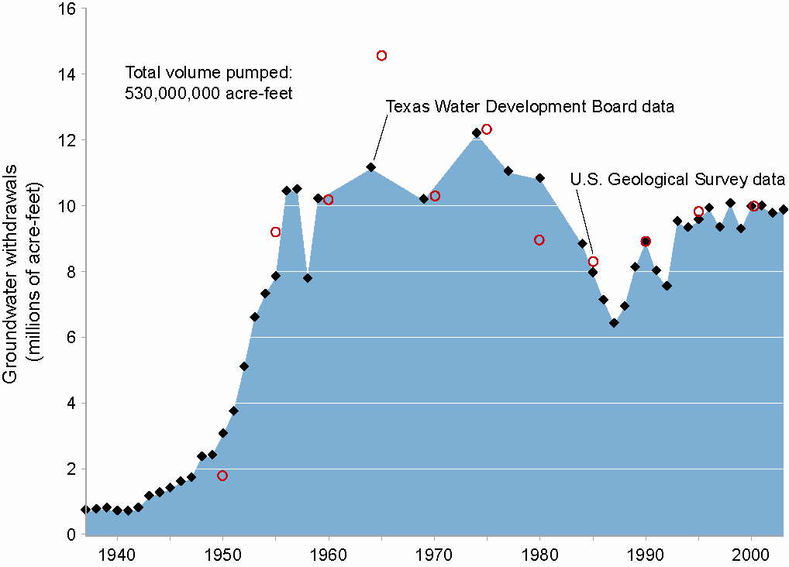
groundwater use in Texas (1937 to 2003)

Slide 38
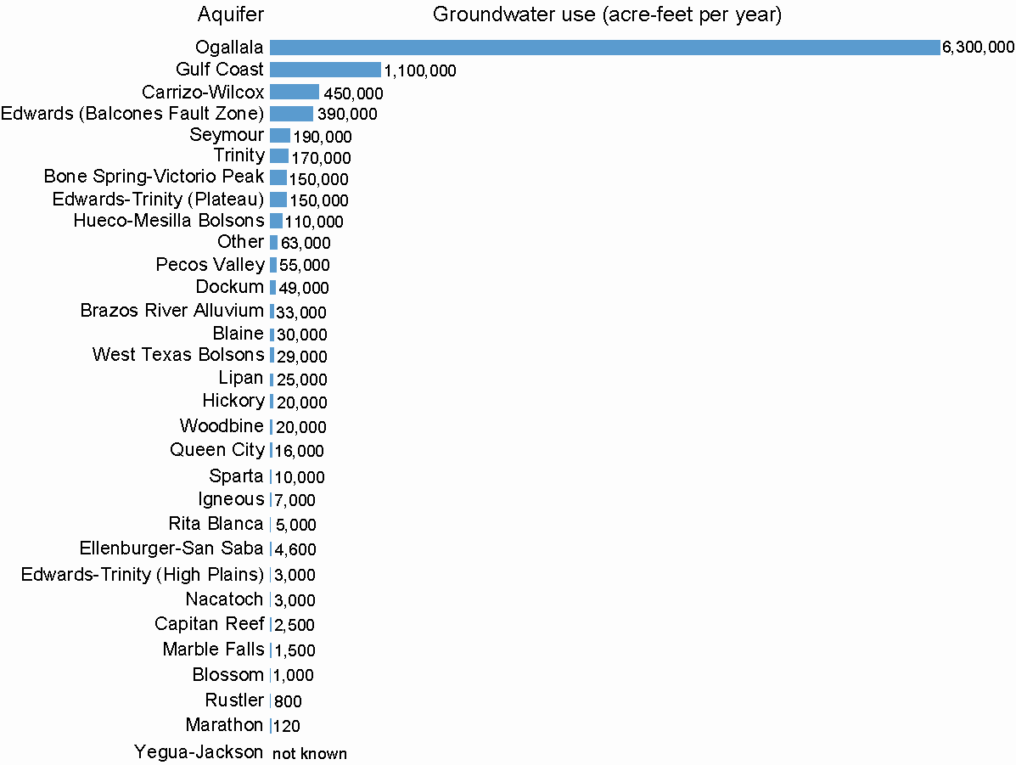
Groundwater Use
by Aquifer, 2003

Slide 39
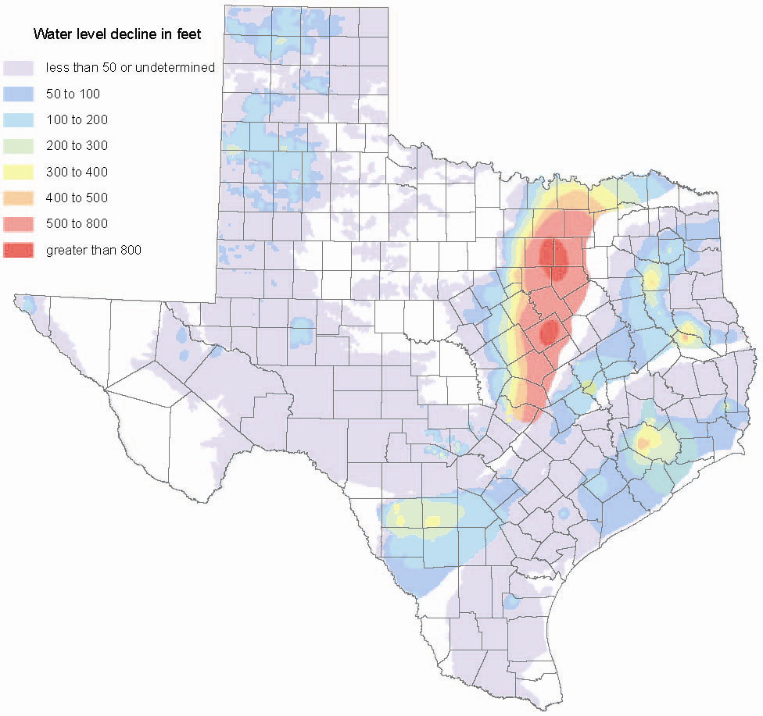
Total water-level
declines in the
major aquifers

Slide 40
Notes:
This graph shows the decline in water levels since 1950 in a well in Lamb County near Lubbock’s well field.
As you can see, water levels here have declined more than 100 feet over the past 60 years, removing more than 60 percent of the water.
Background:
“red bed” = base of the aquifer (the rocks the Ogallala sits on tend to have a reddish color, so the drillers know they’ve hit bottom when they see red drill cuttings

Slide 41
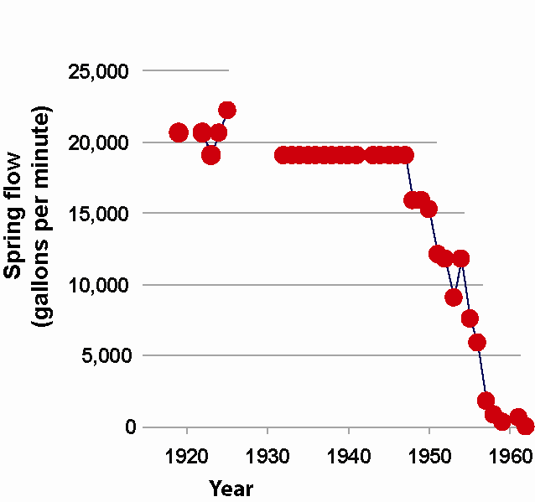
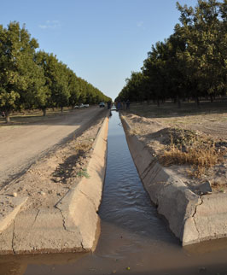
Comanche Springs
Belding Farms
photo from NRCS

Slide 42
land
subsidence
photos from USGS’s Circular 1182

Slide 43
All numbers in acre-feet per year
for Texas
atmosphere
86%
precip
379,000,000
ET
320,000,000
evap
7,200,000
surface water
47,200,000 into lakes and rivers from runoff
4,700,000 into lakes and rivers from rainfall
recharge
5,100,000
baseflow
1,300,000
groundwater
1.3%
Texas coast: 35,000,000
data from Ward and Valdes (1995)
Other states: 9,300,000
85%

Slide 44
Rule of Capture
Governed by districts
  Groundwater conservation
  Subsidence
  Edwards Aquifer Authority
Private property
  Takings?
  Oil and gas law apply?
Notes:
Updates on 2005 lege session

Slide 46
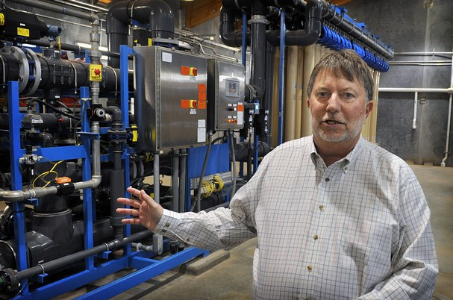
Raw Water Production Facility, Big Spring, Texas
John Grant, Colorado River Municipal Water District
photo by Torin Halsey, Time Record News
Notes:
In another first for the United States (and only the second place in world), Texas has started directly reusing treated wastewater for drinking water.
This photo is of John Grant discussing their plant, a plant we financed, that does this through direct blending: mixing completely cleaned wastewater with raw surface water and then treating the mixture through conventional surface water treatment techniques.
Wichita Falls just started doing the same thing in mid-July. El Paso is working on plans to do the same.

Slide 47
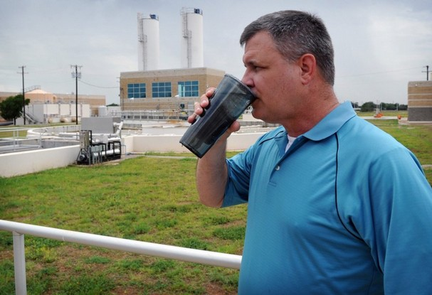
Daniel Nix, City of Wichita Falls, partaking of the water from the reuse project
photo by Torin Halsey, Times Record News

Slide 48

Notes:
Jimmy Fallon

Slide 49
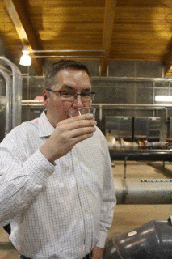

Slide 50
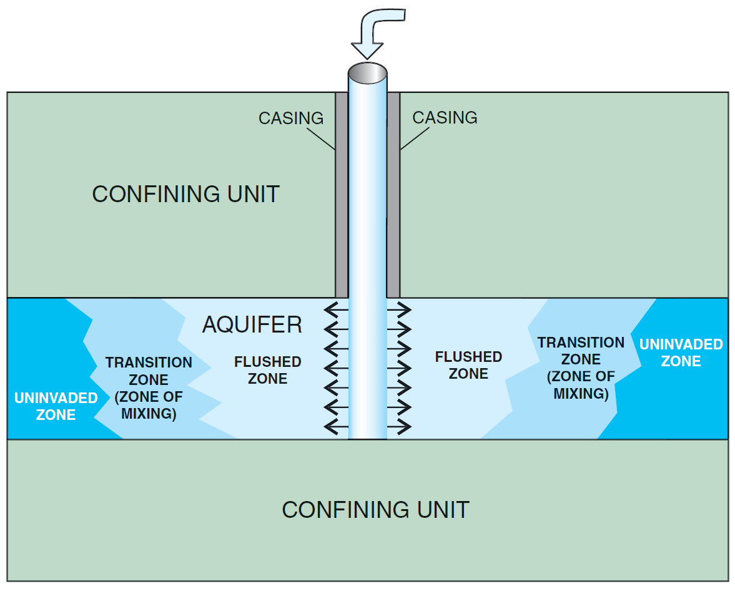
aquifer storage and recovery

Slide 51
PROPOSED DESAL PLANTS IN 2012 STATE WATER PLAN
Proposed seawater desalination plants in the 2012 State Water Plan
Brazos River Authority
San Antonio Water System
dots show approximate
locations of proposed
facilities
Guadalupe-Blanco River Authority
M&G Resins (under construction
and not in the plan)
Corpus Christi
Laguna Madre
Brownsville

Slide 52
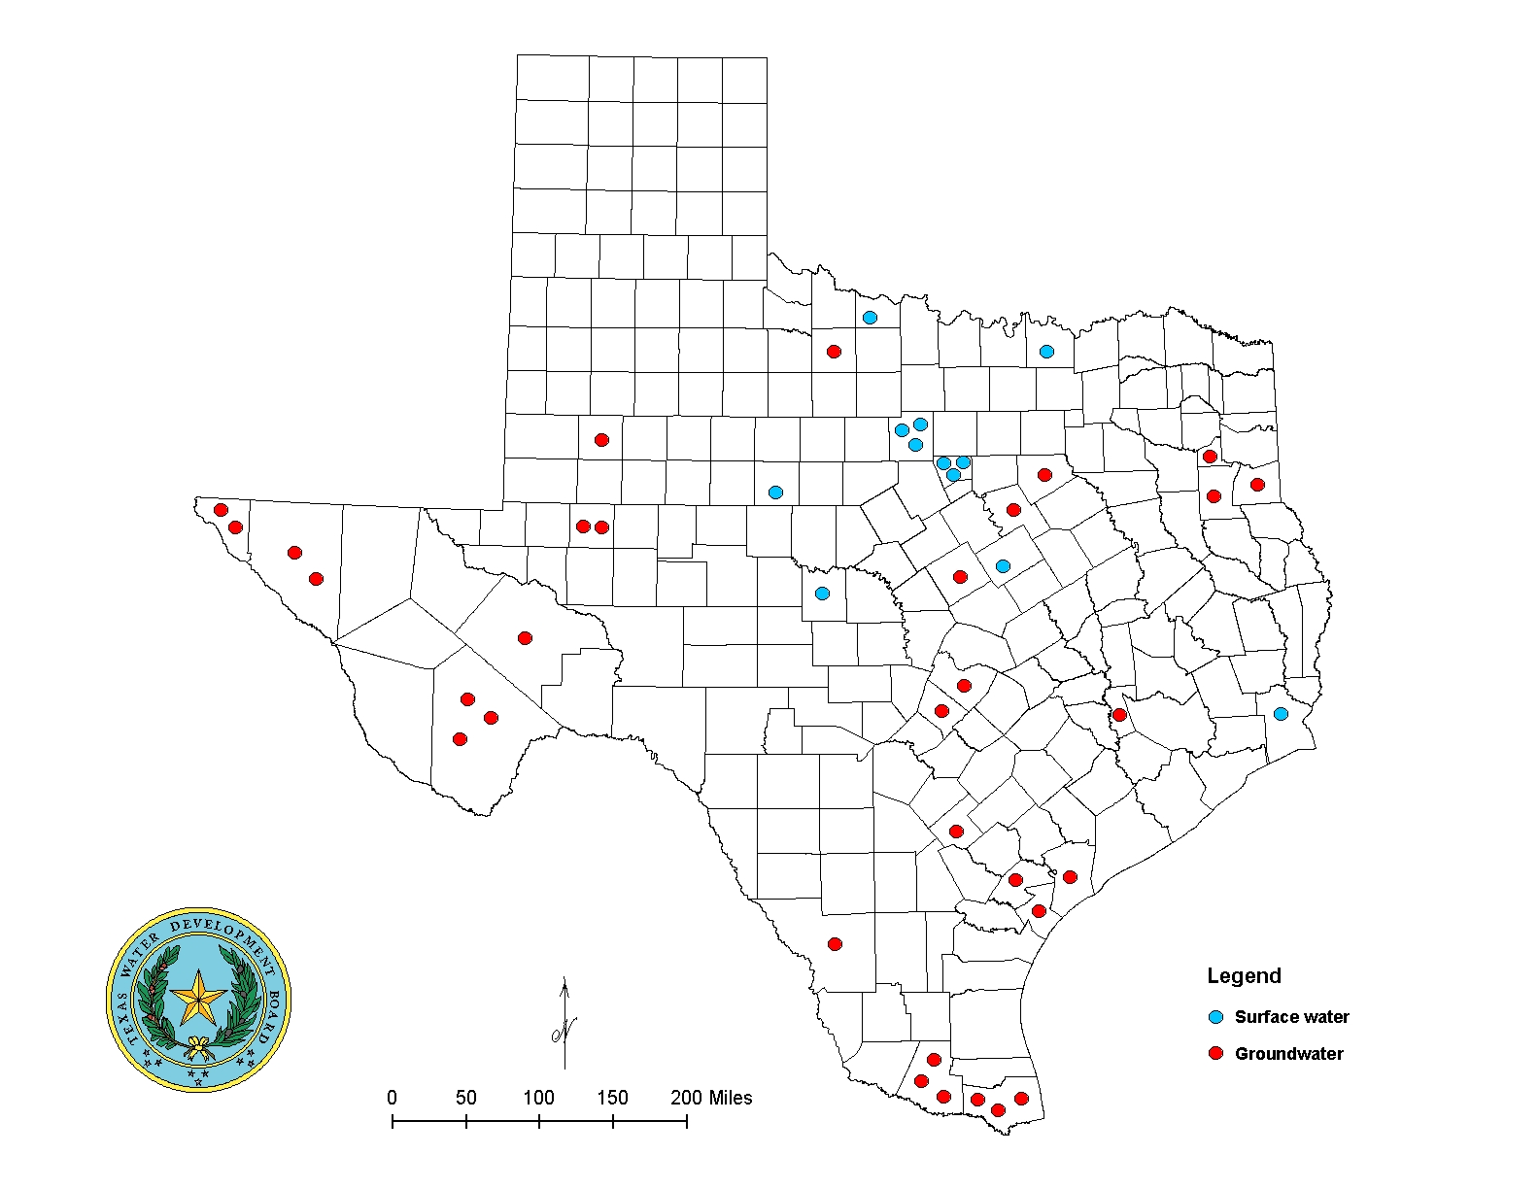
Current Desalination Facilities in Texas
    46 plants are for municipal use and have a design capacity of more than 0.025 million gallons per day
    Overall more than 200 plants in Texas

Slide 53
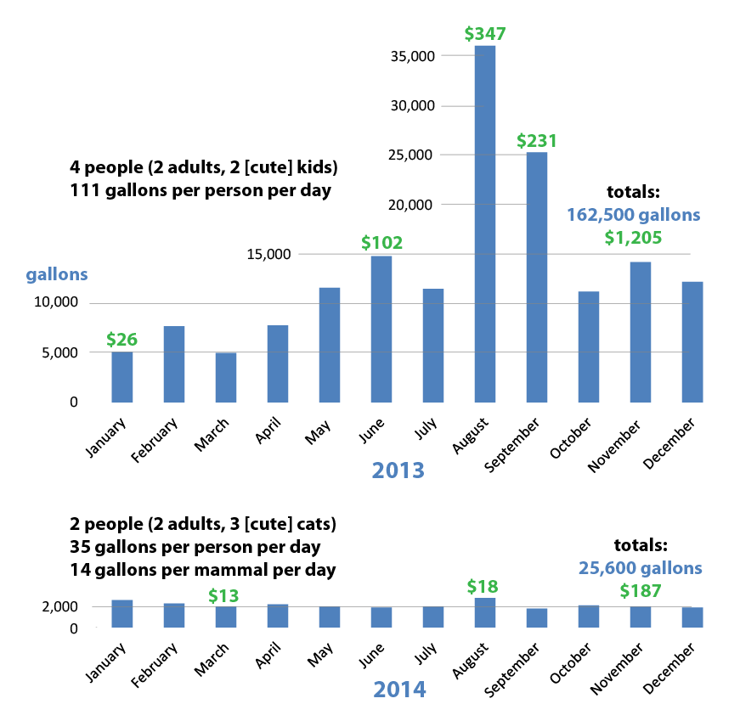
A tale of two Austin families…

Slide 54
A tale of two Austin families…

Slide 55
Texas Water!

Slide 56
Texas Water!
Robert E. Mace, Ph.D., P.G.
(512)936-0861
robert.mace@twdb.texas.gov
@TWDB_DrMace
www.linkedin.com/in/robertemace

